Slide 1

Canadian Association of Optometrists
Age-Related Macular Degeneration (AMD)

Slide 2

AMD
Age-Related Macular Degeneration (AMD) is the leading cause of blindness and low vision in North American adults over 55
AMD affects 1 million Canadians
Number expected to double in 25 years
Notes:
More Canadians have AMD than breast cancer, prostate cancer, Parkinson’s and Alzheimer’s combined
There is low awareness of AMD
With the aging population, the number of AMD patients is expected to double in 25 years

Slide 3
What is Age-Related Macular Degeneration (AMD)?

Slide 4

What is AMD?
As we age, the macula becomes damaged over time
AMD is a progressive eye disease that affects central vision, causing blurriness and low vision
Vision loss can interfere with everyday tasks
The personal, social, and economic costs of AMD can be extremely challenging
Notes:
What is low vision?
A permanent decline in a person’s vision capability that interferes with their ability to perform common visual tasks.

Slide 5
What is the Macula?

Slide 6
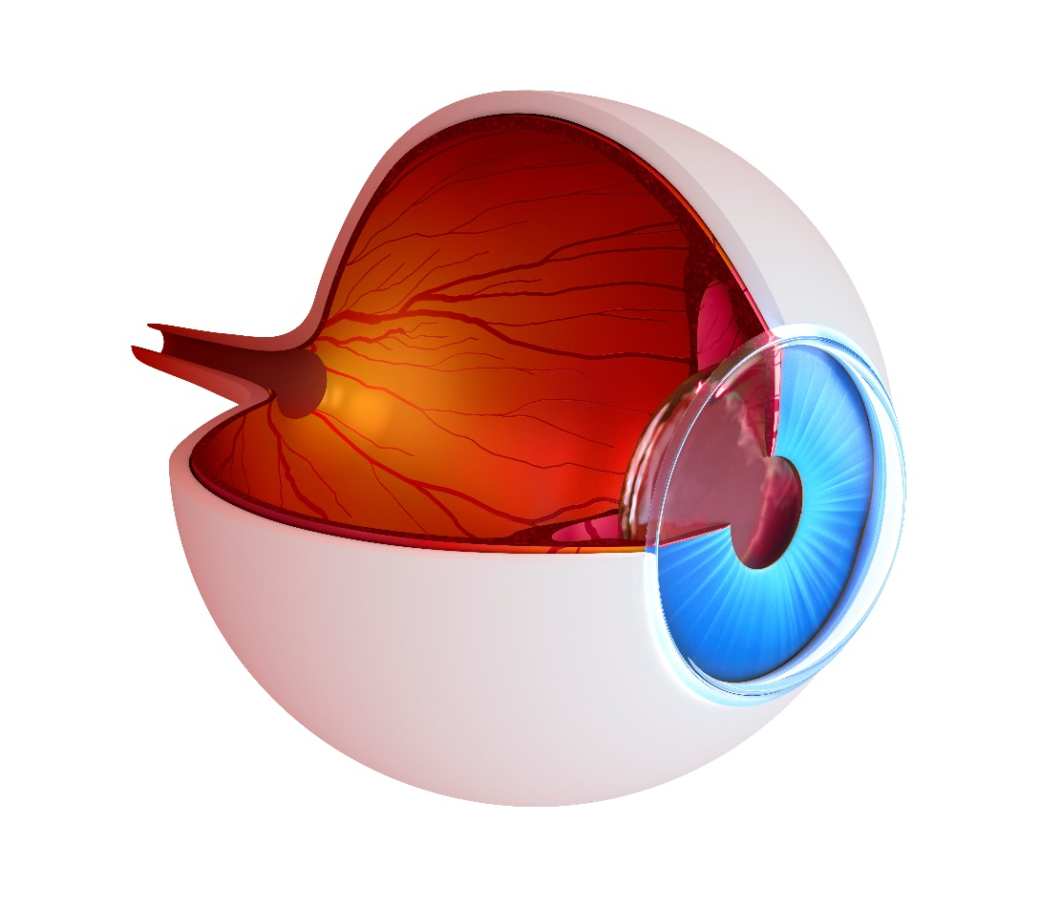
What is the Macula?
The macula is the central most part of the retina (the inner layer at the back of the eye that receives visual information)
Notes:
(think film of a camera)

Slide 7

What is the Macula?
The macula is responsible for central vision and seeing fine details for tasks like reading, recognizing people’s faces and driving

Slide 8
What are the Symptoms?

Slide 9
What are the Symptoms?
In early stages, macular degeneration has no symptoms
Blurriness when performing tasks that require seeing detail
Lines appear distorted and dark spots
Blurry spots that cannot be corrected with glasses
Notes:
Early AMD can be detected during routine eye health examinations.
Glasses cannot correct this blurred spot, or sense there is dirt in the way of clear vision.
Over time, the blurred area may increase in size and interfere with reading and recognizing faces.
Other symptoms of AMD can cause straight lines to look wavy or distorted, and dark spots may blank out portions of the central vision.
Patients experience no pain with AMD.

Slide 10
Are there Different Forms?

Slide 11
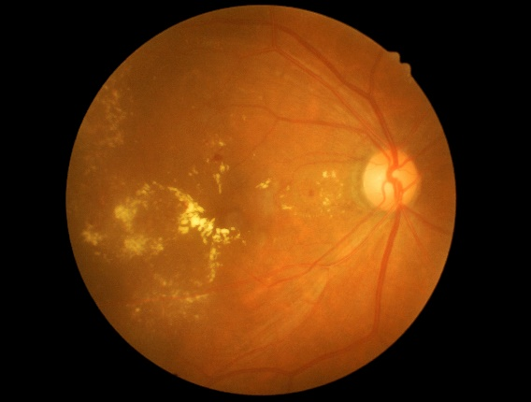
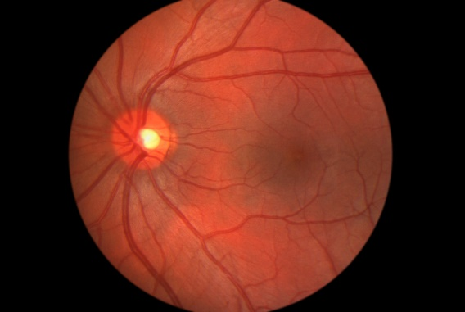
Wet and Dry AMD
There are two forms of AMD: Wet and Dry
Dry AMD:
  Most common
  Mild and gradual
Wet AMD:
  Less common
  Sudden and severe
Notes:
There are two types of AMD: dry and wet.
The most common is the dry form.
This is the milder form where there is a gradual degeneration of the central retinal tissues that make up the macula and symptoms generally develop slowly over time.
The wet form is a sudden leakage, or bleeding, from weak blood vessels under the macula and symptoms progress rapidly.
Wet AMD accounts for approximately 10 per cent of all cases, but the dry form can develop into the wet form over time.

Slide 12
Dry AMD
90 percent of all cases
Usually mild or symptom-free
Occurs when the layer of cells beneath the retina begin to age and thin
Drusen (small deposits that block vision) accumulate under the retina
Can develop into wet AMD over time
Can be detected by a comprehensive eye exam
Notes:
One of the most common early medical signs of dry AMD is the presence of small yellow-white deposits called drusen, which accumulate under the retina.
These deposits may affect the overlying retina, particularly the light-sensitive cells in the macula. But the presence of drusen does not necessarily mean someone will develop AMD.
In fact, many people over the age of 60 have a harmless type of drusen.

Slide 13

Wet AMD
10 percent of all cases
Most severe form
Caused by abnormal blood vessel growth and fluid buildup/leakage
Can cause sudden vision loss within weeks or months
Notes:
Recognizing and then managing wet AMD early can help prevent further vision loss.
That’s why it’s so important to speak with your eye doctor as soon as you notice a change in your vision.
Wet AMD involves the unexpected growth of abnormal blood vessels below the retina, which break into the macula, causing blood and fluid to leak.
Cells in the macula become damaged, resulting in central blind spots and blurred vision. Once wet AMD is present in one eye, the chance of developing it in the other eye is greatly increased.

Slide 14
Who is at risk?

Slide 15

Who is at risk?
The risk of developing AMD increases with age
Increased risk from:
  Smoking
  UV exposure
  Poor diet
  High blood pressure
  Family history
Notes:
The risk of developing AMD increases with age.
High-risk groups include smokers and people who have had extensive UV exposure.
AMD is also associated with conditions such as high blood pressure, arteriosclerosis, and those with a family history of AMD.

Slide 16
Is AMD Preventable?

Slide 17

How to Prevent AMD
Wear proper UV protection
Make healthy lifestyle choices
Good nutrition
Get regular comprehensive eye exams from a doctor of optometry
Notes:
Lifelong UV protection and good nutrition are believed to play a key role in preventing AMD.
Living a healthy lifestyle by keeping your blood pressure down, reducing your intake of fatty foods and not smoking are all recommended. A diet high in antioxidants such as beta-carotene (a form of vitamin A), vitamins C and E, zinc, lutein, zeaxanthin, selenium and omega 3 fatty acids may help prevent AMD. Most of these antioxidants are found in fruits and leafy green vegetables.
Regular eye examinations by a Doctor of Optometry are also important in the early detection of AMD.’
Early signs of AMD may be found during an eye examination even if no symptoms are noticed.
Your Doctor of Optometry can discuss ways to minimize the possibility of vision loss due to AMD.

Slide 18
Is there treatment for AMD?
Notes:
File #: 1461692Exclusive

Slide 19

Treatment
Vitamin Supplements
Dry AMD:
  Exercise
  Sunglasses for UV protection
  Lifestyle changes
Wet AMD:
  Eye Injections
Notes:
Currently, dry AMD is treated with ocular vitamin supplementation and lifestyle modifications such as exercise, sunglasses to reduce UV radiation and smoking cessation.
Many cases of wet AMD can be treated with medications injected into the eye to stop leaking blood vessels.
Early detection and prompt intervention are crucial to addressing wet AMD. Certain vitamins can also assist in slowing down the progression of AMD.
The use of vitamins will not reverse any vision loss that has already occurred, nor will it stop the progression of AMD completely. Regular eye examinations and counseling from your Doctor of Optometry will let you know when new treatments become available.

Slide 20
Is there help available?

Slide 21
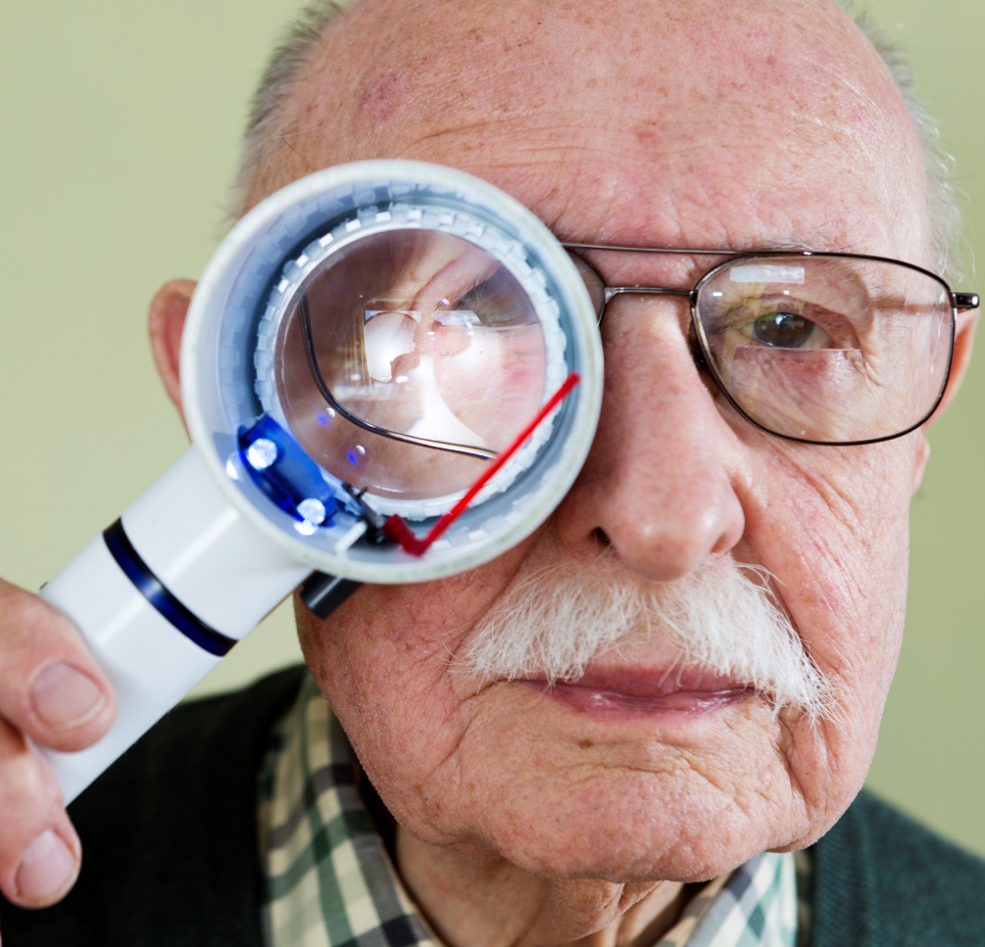
Managing AMD
Low vision aids to maximize remaining vision
Using an Amsler Grid to help measure the progression of AMD
Frequent visits with your doctor of optometry
Notes:
Many patients with sight loss due to AMD can benefit from low vision aids. Your Doctor of Optometry can prescribe magnifying devices to enhance both distance and reading vision. These aids will not restore sight to normal levels but they allow people to maximize their remaining vision. Your Doctor of Optometry may also train you to use an Amsler grid, which is a tool that can assist in testing the progression of AMD at home. It is important to contact your Doctor of Optometry if you notice any changes in your central vision.

Slide 22
Thank You.

